Slide 1
Preferential Attachment Model Addition/Deletion of Edges
MA 653: Network Science
Instructor: Ashok Singh Sairam
ashok@iitg.ac.in

Slide 2
Extensions of preferential attachment
Price and BA models include many oversimplified assumptions for the way networks grow
In particular, they assume that nodes and edges are only created (never deleted) and a vertex can initiate new edges only at the time of creation
While these assumptions might hold with good approximation for citation networks they do not hold true for other types of networks
In Web links are not permanent and can be created at any time
Entire webpages can also disappear (vertex removal)
Why the preferential attachment should be linear in the degree?

Slide 3
Addition of extra edges
While in citation networks no new edges can be created by a vertex after the time of the node generation this is not true for the majority of the networks
For example, the WWW is constantly changing
A network evolution model that can deal with the creation of new edges is the following:
At each step, the new node creates exactly c new edges which attach to other vertices with probability proportional to degree k [same as before]
In addition, at each step some number w of extra edges are added to the network with both ends attaching to vertices chosen in proportional to degree
Thus, when the network has n vertices it will have n(c+w) edges

Slide 4
Addition of extra edges
Every new node brings c+2w ends of edges
2 extra for each of the w extra edges
The normalization factor for the attaching probabilities is the sum of the degree of all nodes
This is equal to twice the number of edges, that is, 2n(c+w)
The probability that a node with degree k will attract one of the new edges is:
p_{k}(n) is the fraction of nodes with degree k when the network has n vertices

Slide 5

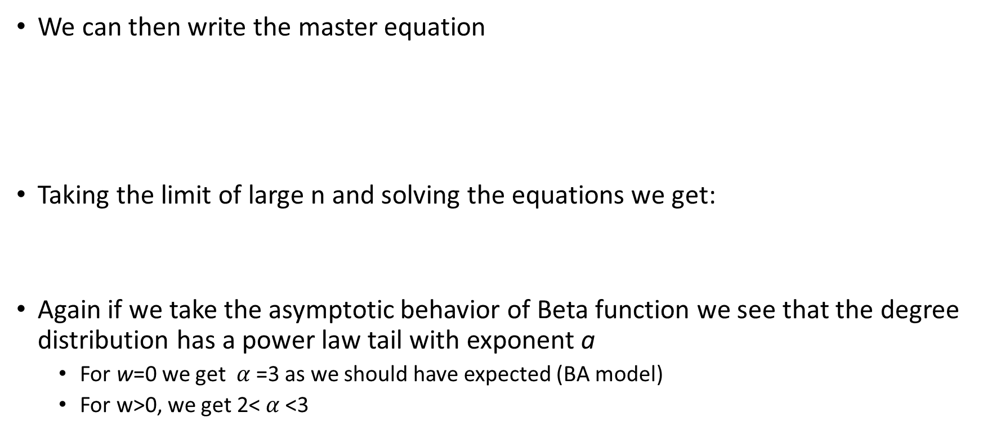
Addition of extra edges
We can then write the master equation
Taking the limit of large n and solving the equations we get:
Again if we take the asymptotic behavior of Beta function we see that the degree distribution has a power law tail with exponent a
For w=0 we get $α$=3 as we should have expected (BA model)
For w>0, we get 2< $α$<3
$$p_{k}=\frac{B(k,α)}{B(c,α−1)} where α=2+\frac{c}{c+2w}$$

Slide 6
Removal of edges
Edges can be removed as well in many networks
Here we begin with an extension of the original BA model to account for deletion of edges at each step (edges additions are still only happening at the initial creation of a vertex)
In particular, at each step a new vertex is created with c edges associated with him
These edges are attached to existing nodes with the original BA process, that is, proportional to the existing nodes degrees
At each step we also remove u edges from the existing ones
The edges that are deleted are picked uniformly at random
The probability that a node of degree k_{i} loses one of its edges is:

Slide 7
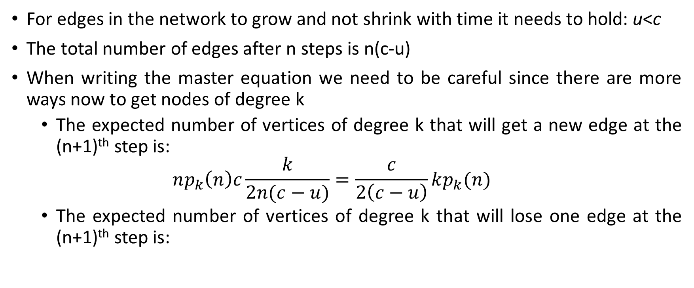
Removal of edges
For edges in the network to grow and not shrink with time it needs to hold: u<c
The total number of edges after n steps is n(c-u)
When writing the master equation we need to be careful since there are more ways now to get nodes of degree k
The expected number of vertices of degree k that will get a new edge at the (n+1)^{th} step is:
$$np_{k}\left(n\right)c\frac{k}{2n(c−u)}=\frac{c}{2\left(c−u\right)}kp_{k}(n)$$
The expected number of vertices of degree k that will lose one edge at the (n+1)^{th} step is:

Slide 8
Removal of edges
As it should be evident nodes now can have degrees less than c as well
The master equation takes the following form:
These equations can be combined to:
Problem arises for k=0, since it involves p₋₁(n). To overcome this problem we define p₋₁=0

Slide 9
Addition/Removal of edges
This extension of BA model accounts only for removal of edges, while it allows creation of edges only during the initial creation of a vertex
We can easily add to the above process the addition of w edges (on top of the c edges created by the new vertex) at every node creation instance
The master equation takes the form:
In this case we require u<w+c

Slide 10
Addition/Removal of edges
Taking the limit of large n we can obtain the equations for p_{k}
However, as we can observe they are different in some aspect from what we have seen until now
In particular, they involve probabilities for 3 degrees
k-1, k and k+1
The presence of three different degree terms makes it substantially more difficult to solve
We need to make use of the generating functions and eventually we obtain a first-order linear differential equation

Slide 11
Addition/Removal of edges
The final result for a large k (and u<w+(1/2)c) is:
As we can see this extension of the model provides a power law tail again
The exponent can take values both greater and smaller than 2
However, for u=w+(1/2)c, the exponent becomes infinite
At this point we lose the power law behavior and the distribution becomes a stretched exponential
Also for u >w+(1/2)c, the solution becomes nonsensical and we need to solve the differential equation with other methods

Slide 12
Exercise
Ex. 13.5: Consider the following variant of the Barabási-Albert model. Nodes are added one-by-one to a growing undirected network. Each node having initial degree c. The c edges emanating from a newly added node connect to previously existing nodes i with probability k_{i}+a.
Given that c edges are added to the network with each node, what is the mean degree of a node in the network in the limit of large network size?
Derive the master equation that gives the fraction of nodes p_{k} having degree k in the limit of large network size. If necessary give an additional rate equation to cover any special-case value of k.

